Slide 1

Sparse Sensing

Slide 2


DT Capabilities
ORNL AGING
SRAW
Core Capability
Reliability Analysis
RAVEN Plugin
Model Predictive Control (MPC)
[Un]supervised Learning
Future capability
SR²ML
1. Physical Space
Cyber Resilience and DSP/TSA
Sparse Learning
(ASI, P&ID, BOM, Actuators)
SONAR
SPSL
2. Digital/Virtual Space
(CAD/GUIs/Analytics)
Model/data assimilation/adjustment
Reinforcement Learning
3. Data Space
https://github.com/idaholab/raven/wiki
TEAL
VISP
(Storage, Connectivity, IIoT)
Economical Modeling
VV&Q
4. Services Space
LOGOS
ANL FARM
Anomaly detection
HERON
Optimization
(Prediction/Monitoring/Control)
System Optimization

Slide 3
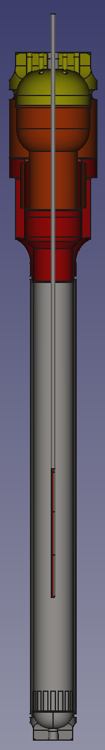
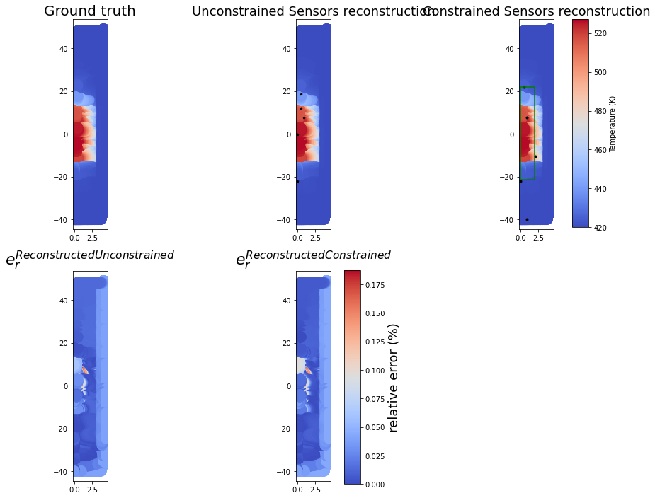
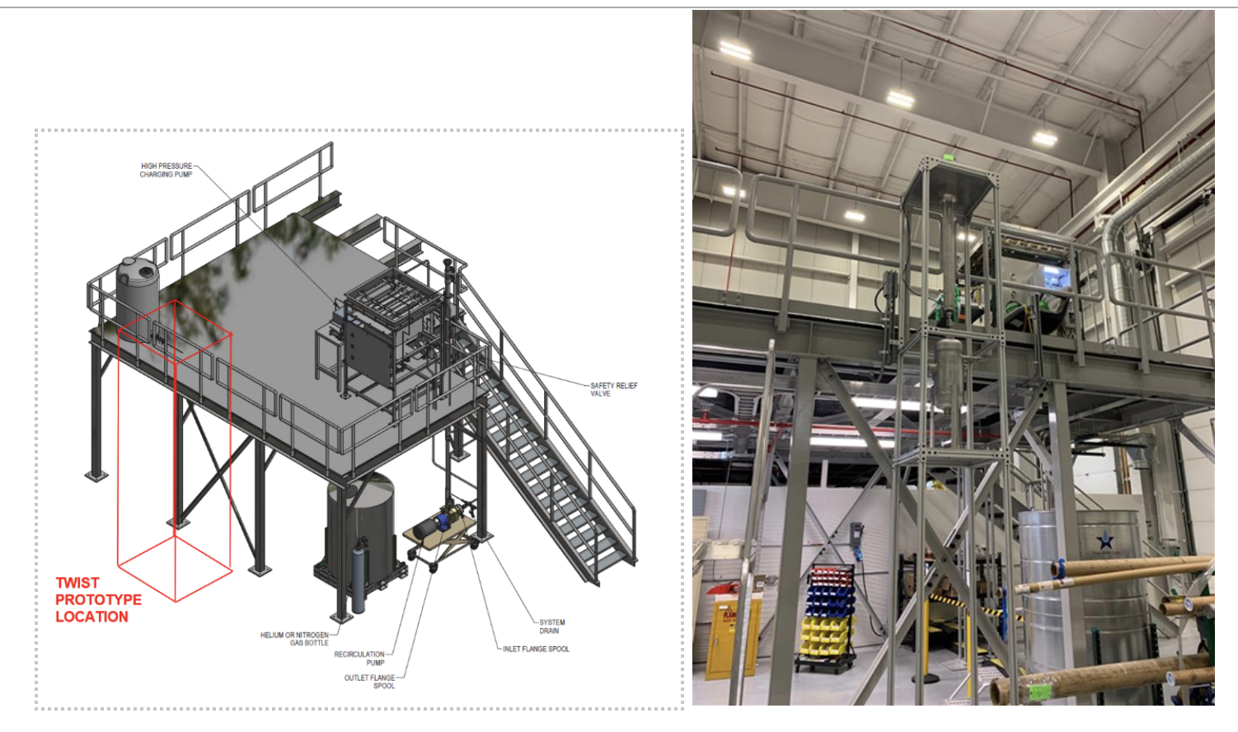
Unique Capability: Sparse Sensing
Risk/
Reliability Analysis
Problem Statement: Enable sparse sensing and sparse learning in nuclear digital twins through reconstruction of reactor core flow fields, using optimal sensor placement with spatial constraints
Model Predictive Control (MPC)
ML/AI
Sparse Learning
Cyber Resilience and DSP/TSA
Sparse Learning
SPSL
Opti-TWIST Capsule
Model/data assimilationadjustment
Reinforcement Learning
Economical Modeling
Validation, Verification and Qualification (VVQ)
n = All possible sensor locations
r = Selected sensors
$s_{c}$= Constrained locations
s = Maximum sensors in Constrained region
Anomaly detection
Optimization
System Optimization

Slide 4
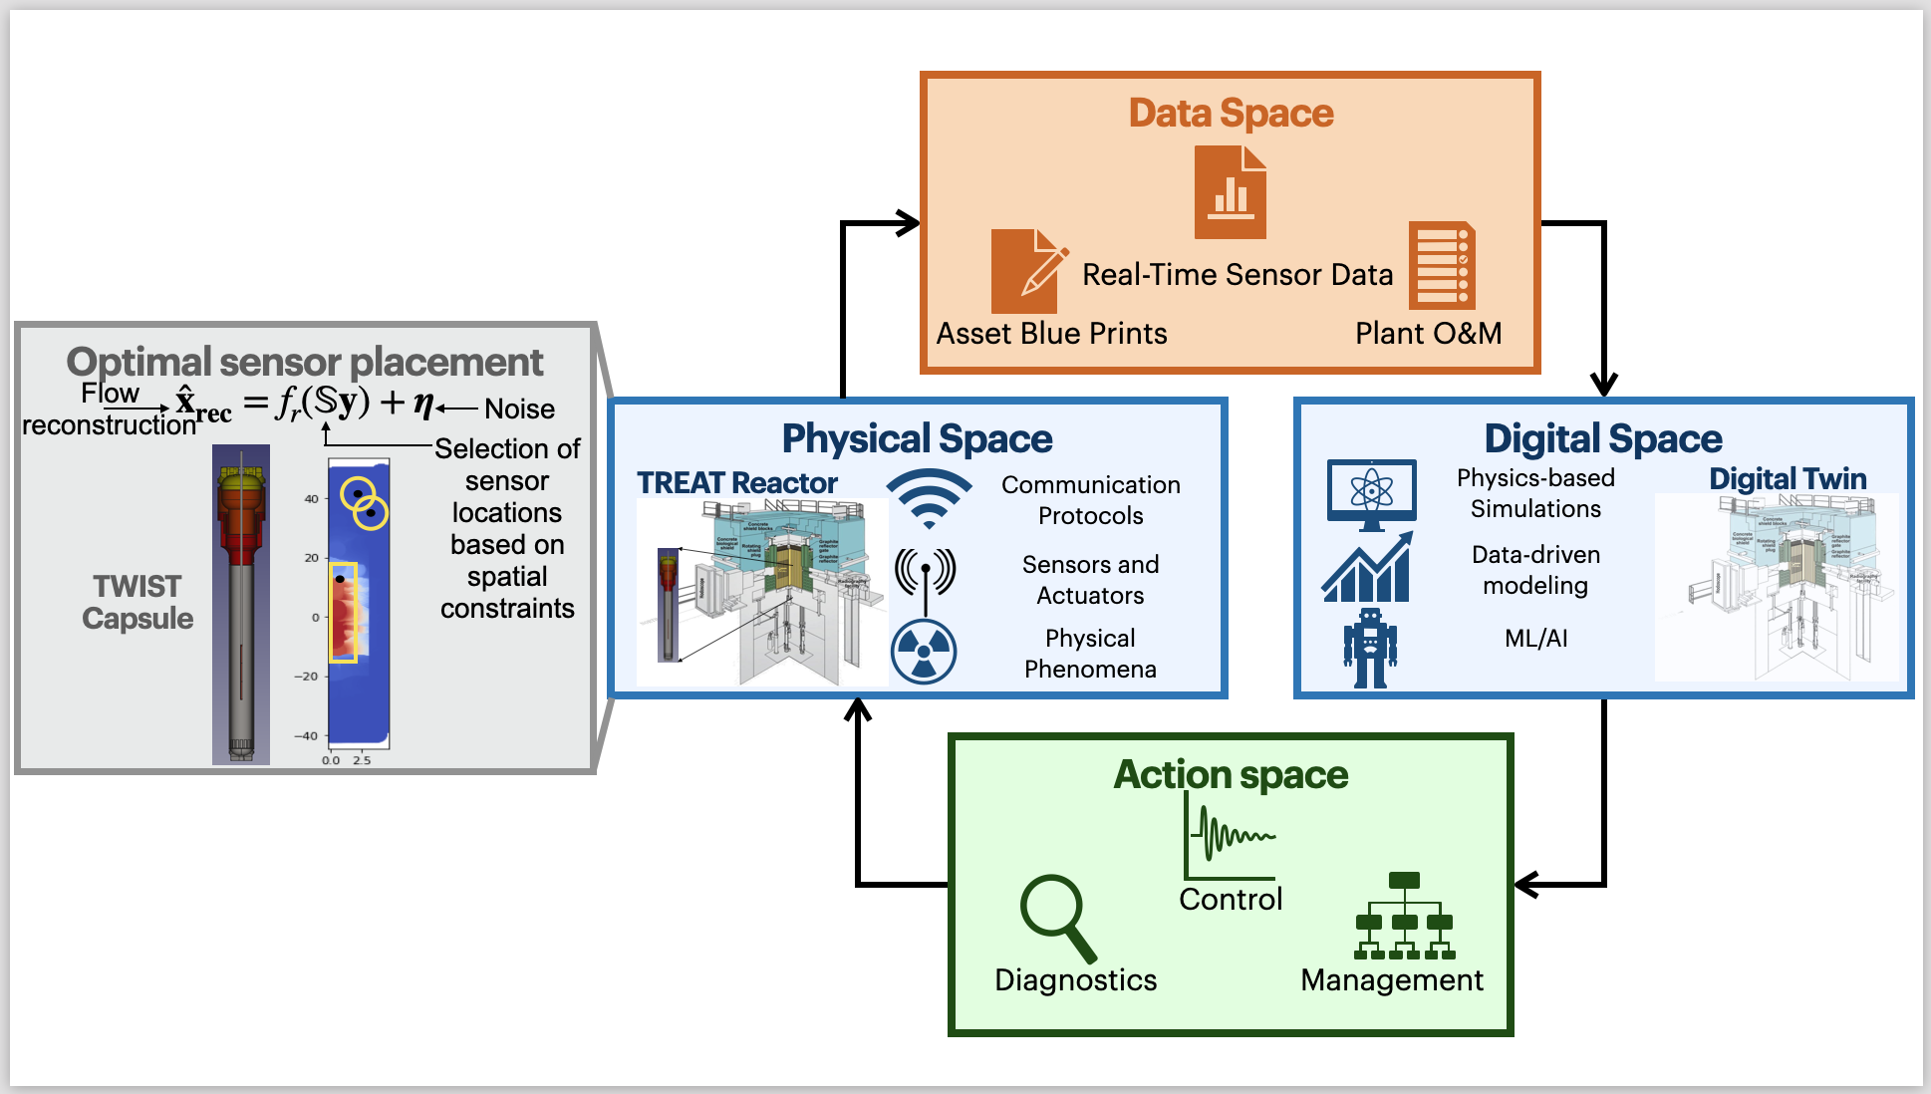
OPTI-TWIST Prototype

Slide 5
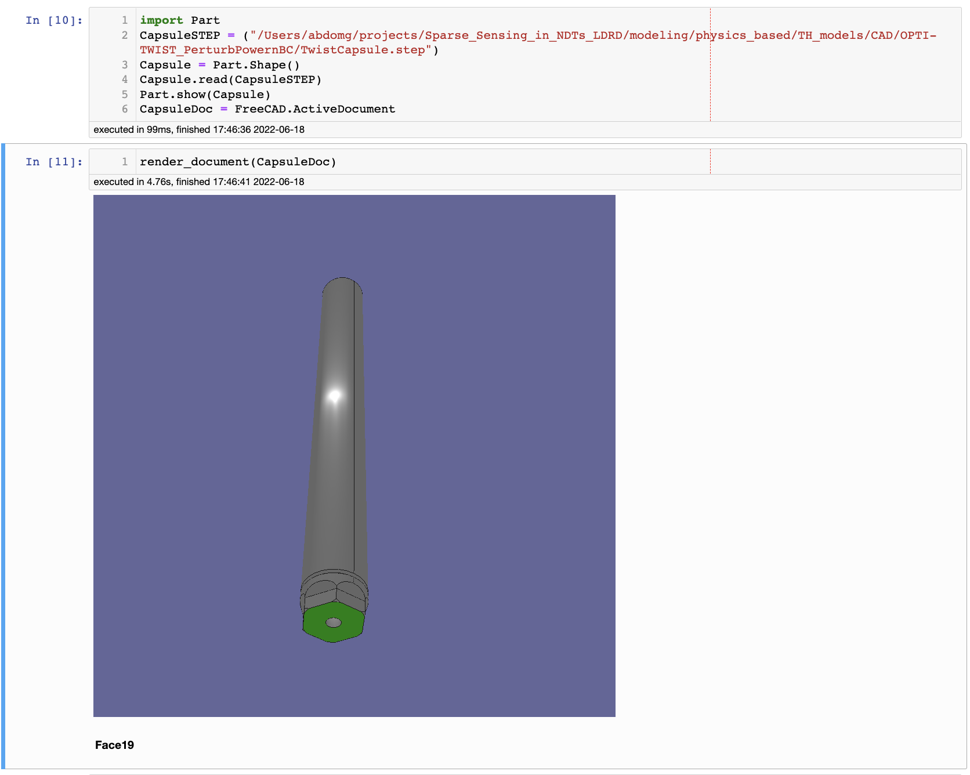


Visualization
1. Physical Space
(ASI, P&ID, BOM, Actuators)
2. Digital/Virtual Space
(CAD/GUIs/Analytics)
3. Data Space
(Storage, Connectivity, IIoT)
4. Services Space
(Prediction/Monitoring/Control)

Slide 6
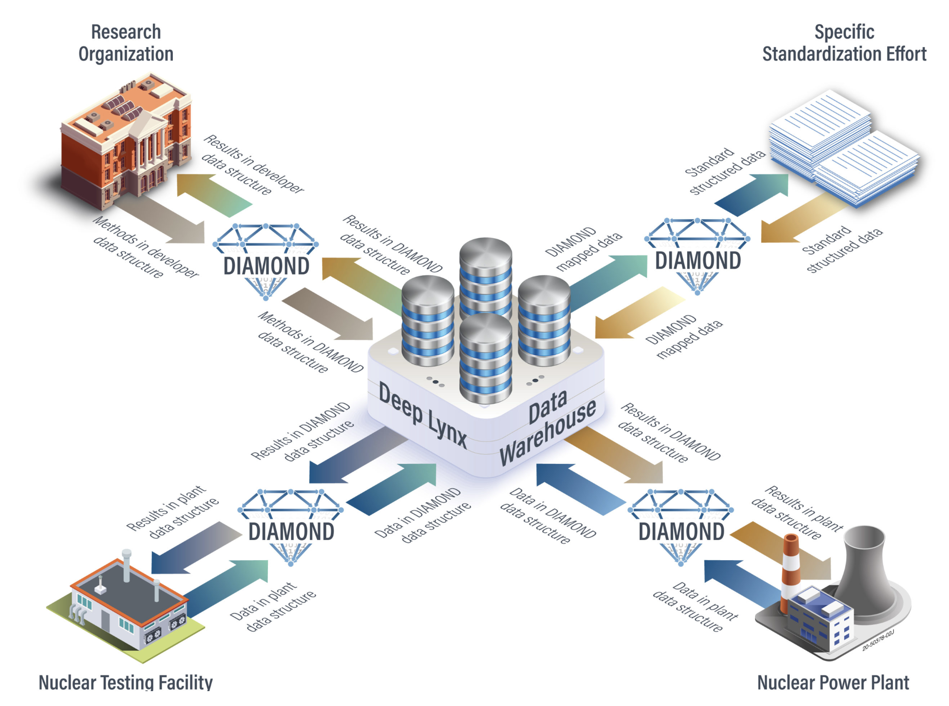
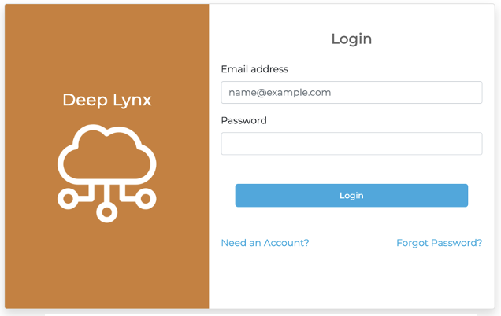
Data warehouse
1. Physical Space
(ASI, P&ID, BOM, Actuators)
2. Digital/Virtual Space
(CAD/GUIs/Analytics)
3. Data Space
(Storage, Connectivity, IIoT)
4. Services Space
(Prediction/Monitoring/Control)

Slide 7
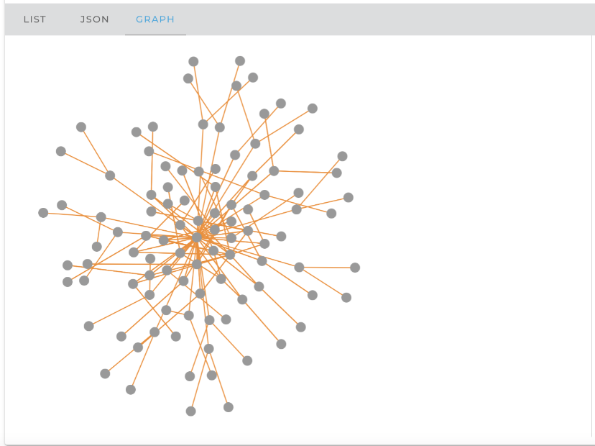

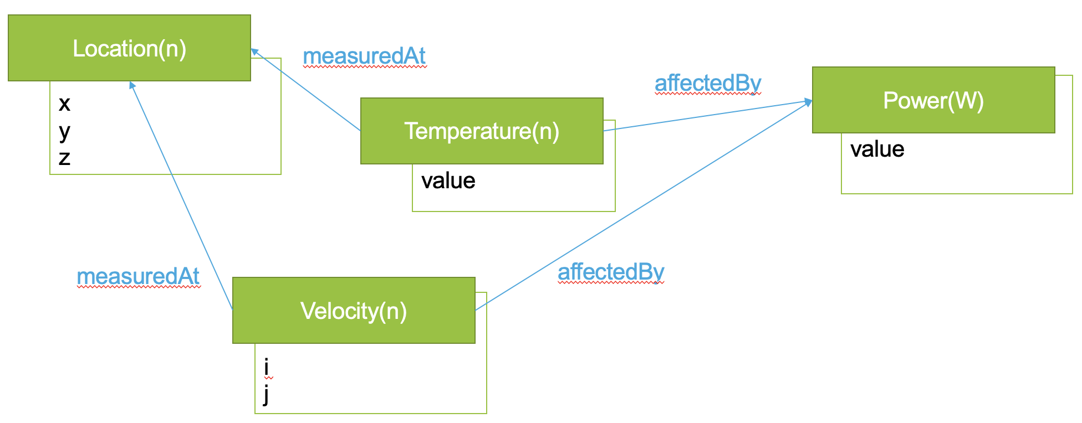
Data warehouse
1. Physical Space
(ASI, P&ID, BOM, Actuators)
2. Digital/Virtual Space
(CAD/GUIs/Analytics)
3. Data Space
(Storage, Connectivity, IIoT)
4. Services Space
(Prediction/Monitoring/Control)

Slide 8
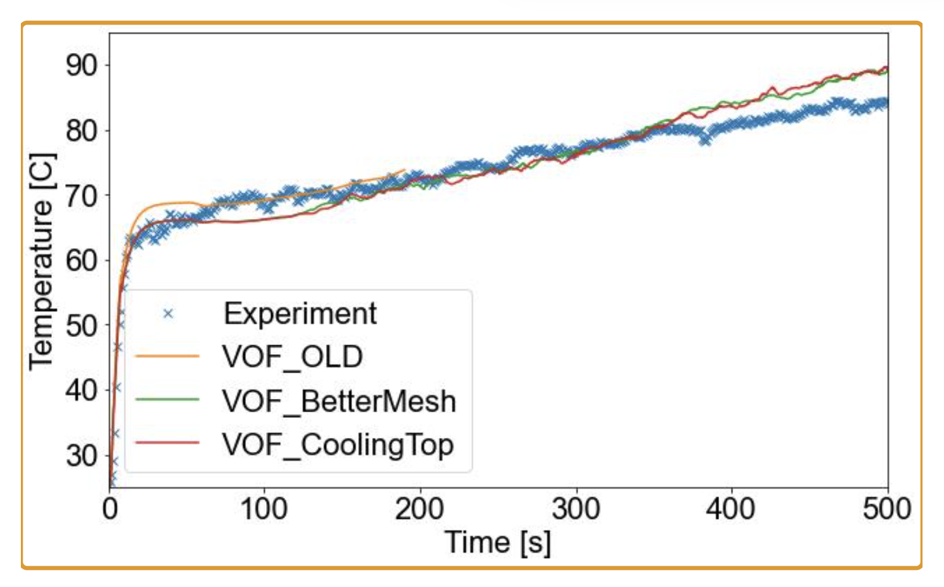
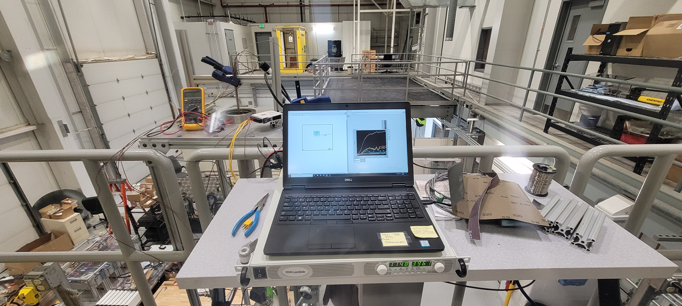
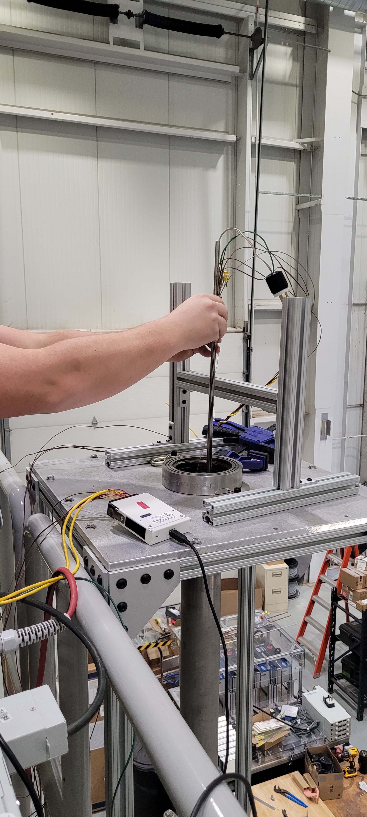
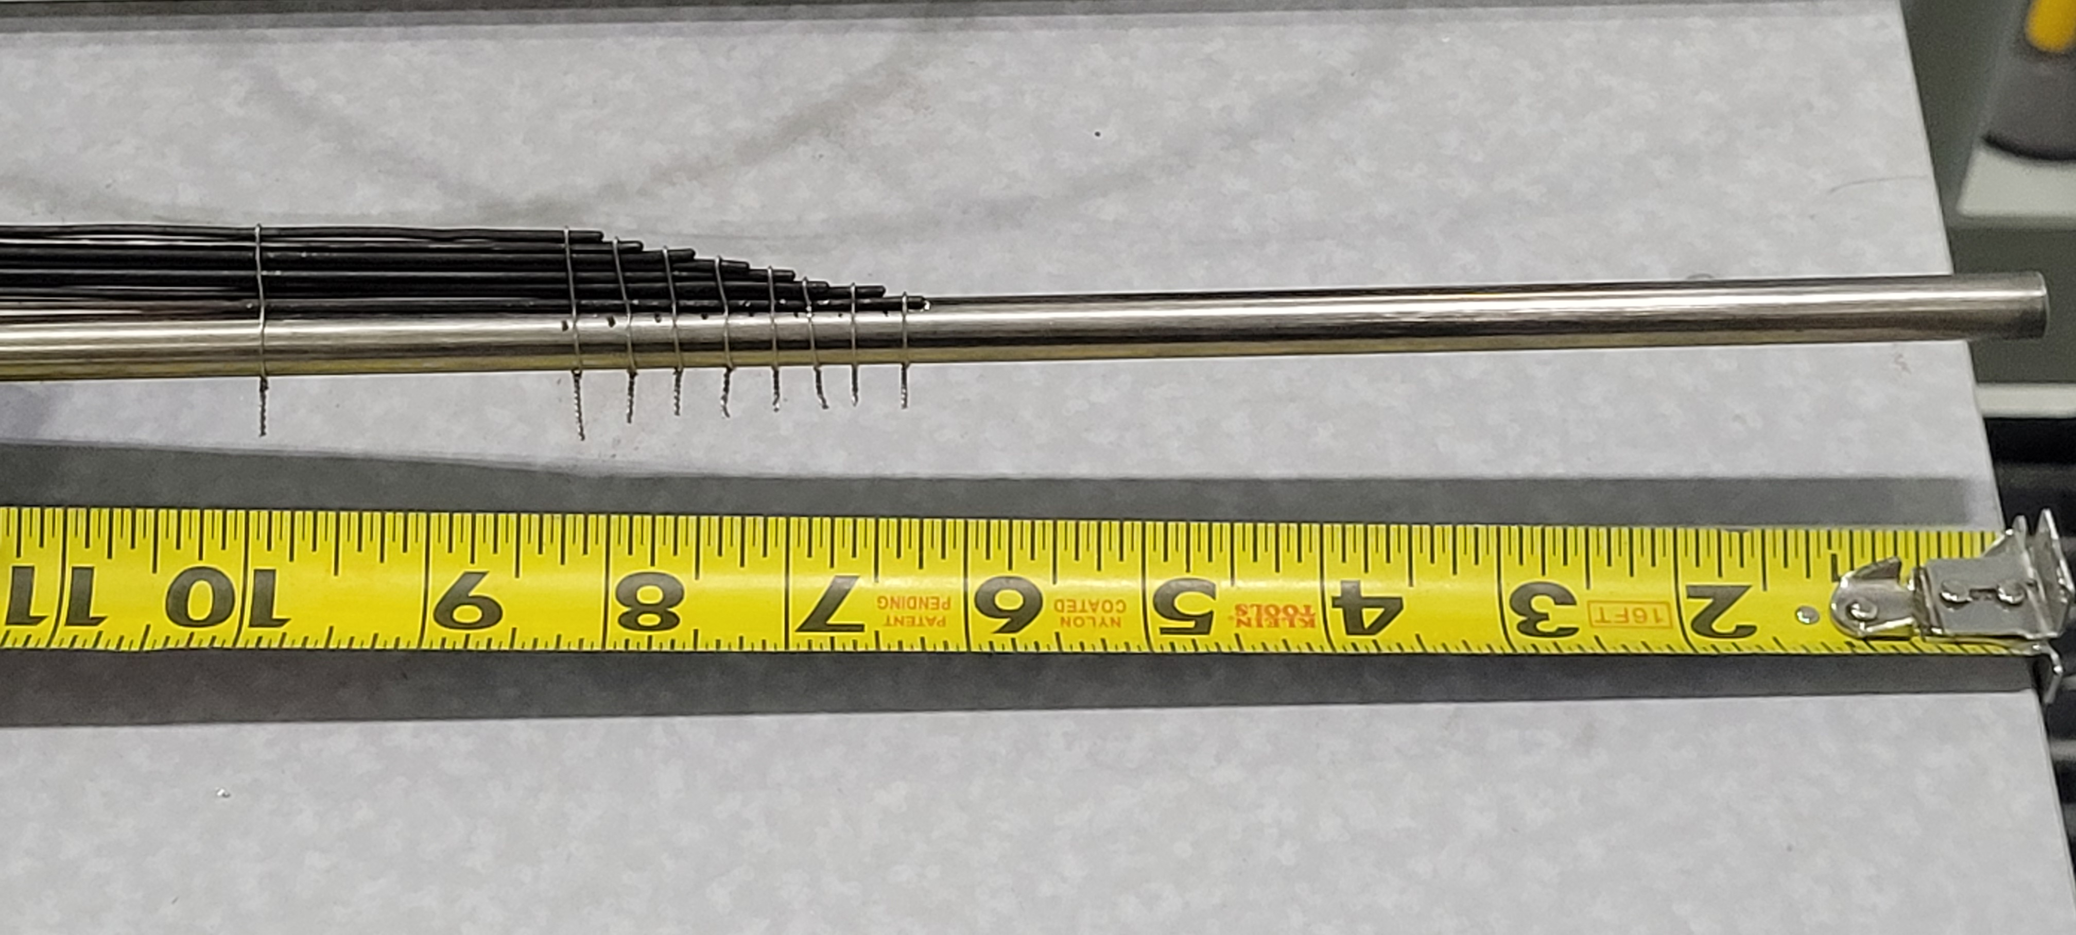
Model Calibration Experiment(s)
Image courtesy : Idaho National Laboratory (INL)

Slide 9
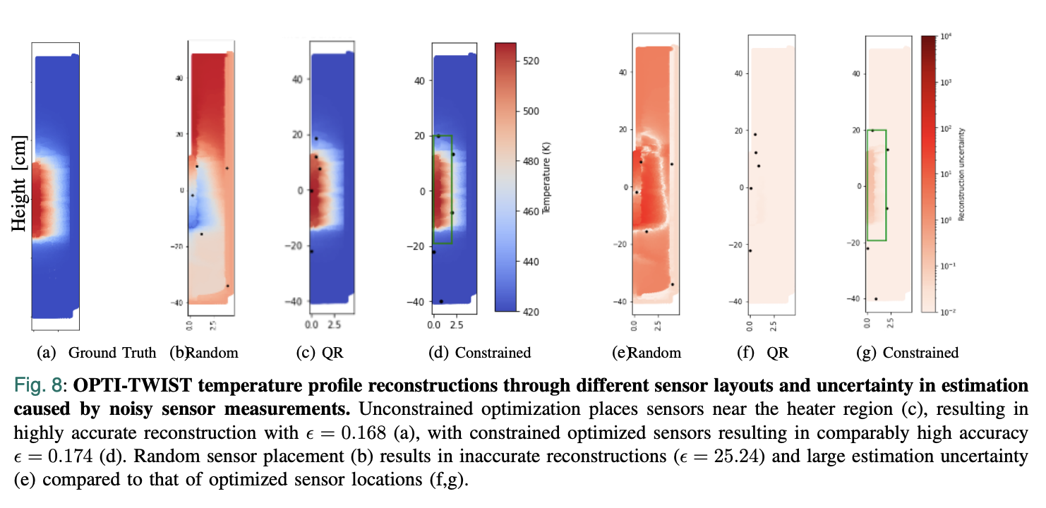
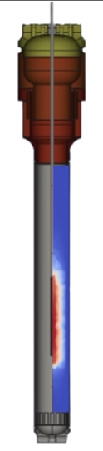
Uncertainty Quantification – Reconstruction and Heatmaps

Slide 10
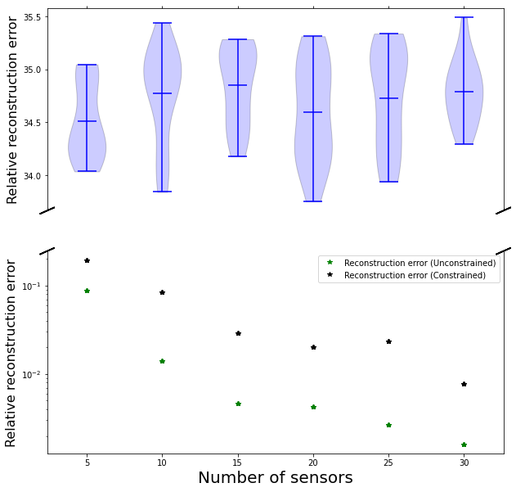
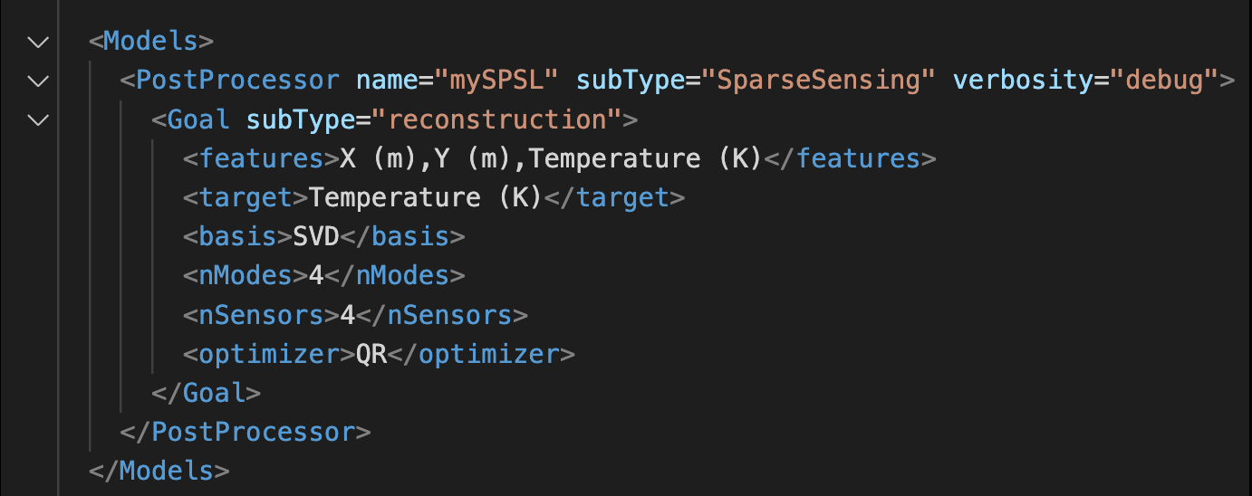
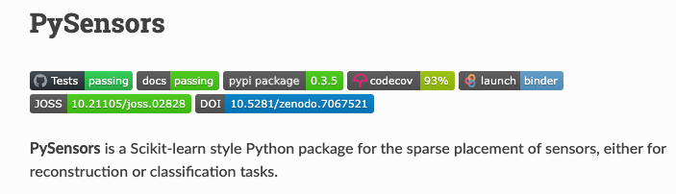
Conclusions
Reconstruction error decreases with more optimized sensors (unconstrained or constrained)
Random placements still suffer from high error even with additional sensors.
Implemented in RAVEN and PySensors (Open-source softwares)

Slide 11
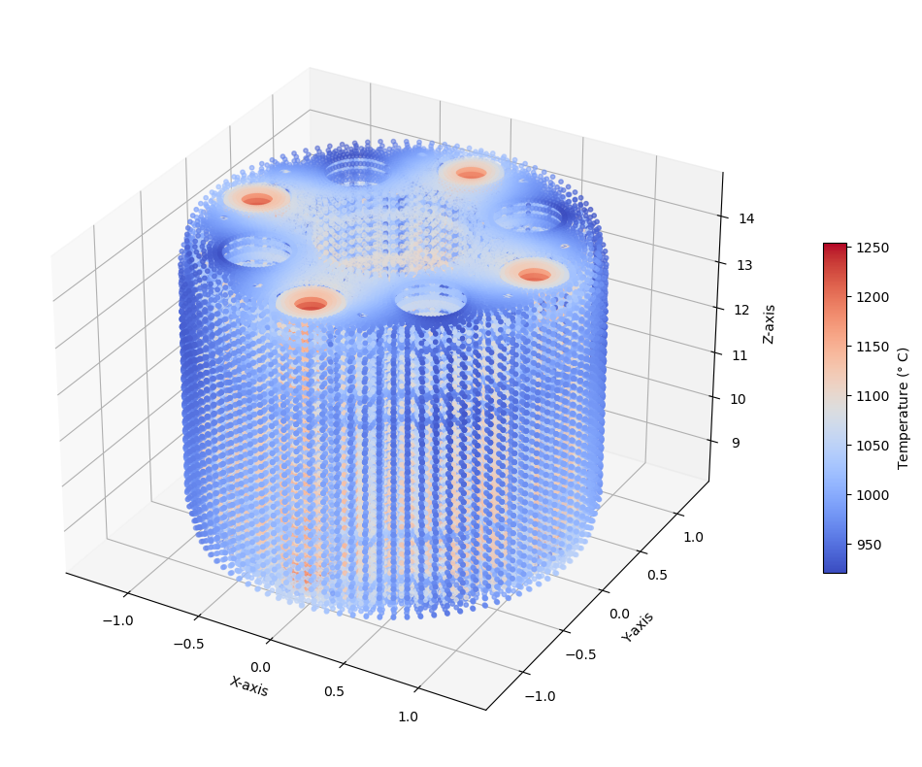
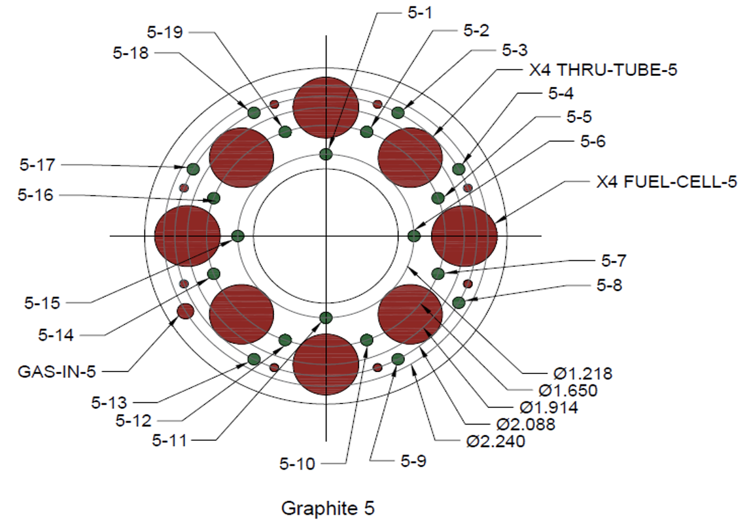
Industrial App. 1 - Nuclear Fuel Capsules
Goal 1 : Optimize height (Z-axis) at which thermocouples should be placed inside the fuel to reconstruct fuel temperature profile.
Goal 2 : Choose best thermocouple locations on the graphite holder from all the green holes shown in Figure 1 to reconstruct the fuel temperature profile.
Figure 1 : Top view of Graphite Holder 5 with thermocouple locations.
Figure 2 : Graphite Holder 5 with fuel in 3D.

Slide 12
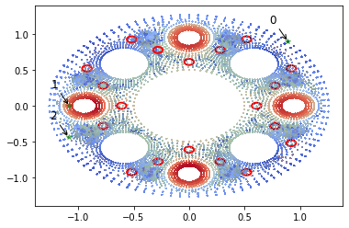
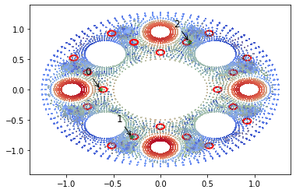
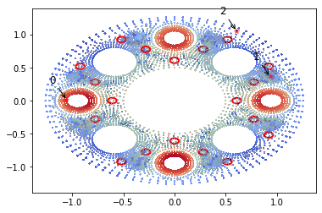
TRISO Fuel Irradiation Experiment
Unconstrained
Constrained
Random
Sensor | X | Y | Z
0 | 0.892 | 0.892 | 12.3080
1 | -1.081 | 0.000 | 14.1535
2 | -1.088 | -0.438 | 9.8000
Sensor | X | Y | Z
0 | -0.638 | 0.005 | 9.000
1 | -0.302 | -0.781 | 11.154
2 | 0.306 | 0.783 | 14.167
Sensor | X | Y | Z
0 | -1.050 | 0.110 | 11.346
1 | 0.857 | 0.252 | 14.000
2 | 0.615 | 0.892 | 10.962

Slide 13
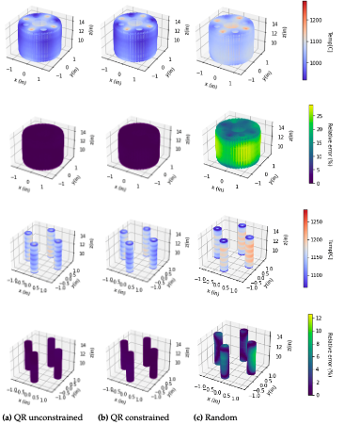
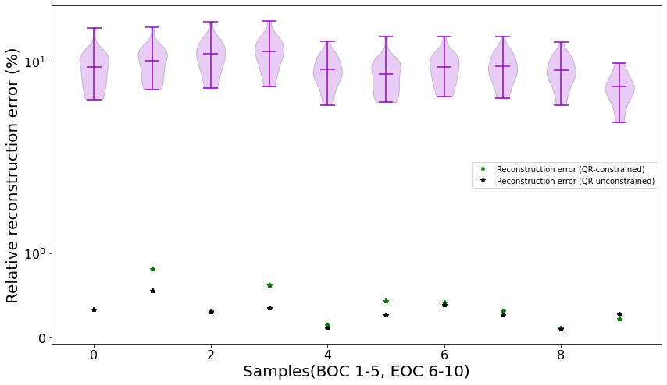
TRISO Fuel Temperature Reconstruction
(a-c) Temperature profile reconstructions (d-e) Relative reconstruction errors. Unconstrained optimization leads to a maximum reconstruction error of ε = 0.75% (a,d), while introduction constraints results in ε = 1% (b,e). Random sensor placement (c,f) results in inaccurate reconstructions ε = 25% compared to that of optimized sensor locations

Slide 14
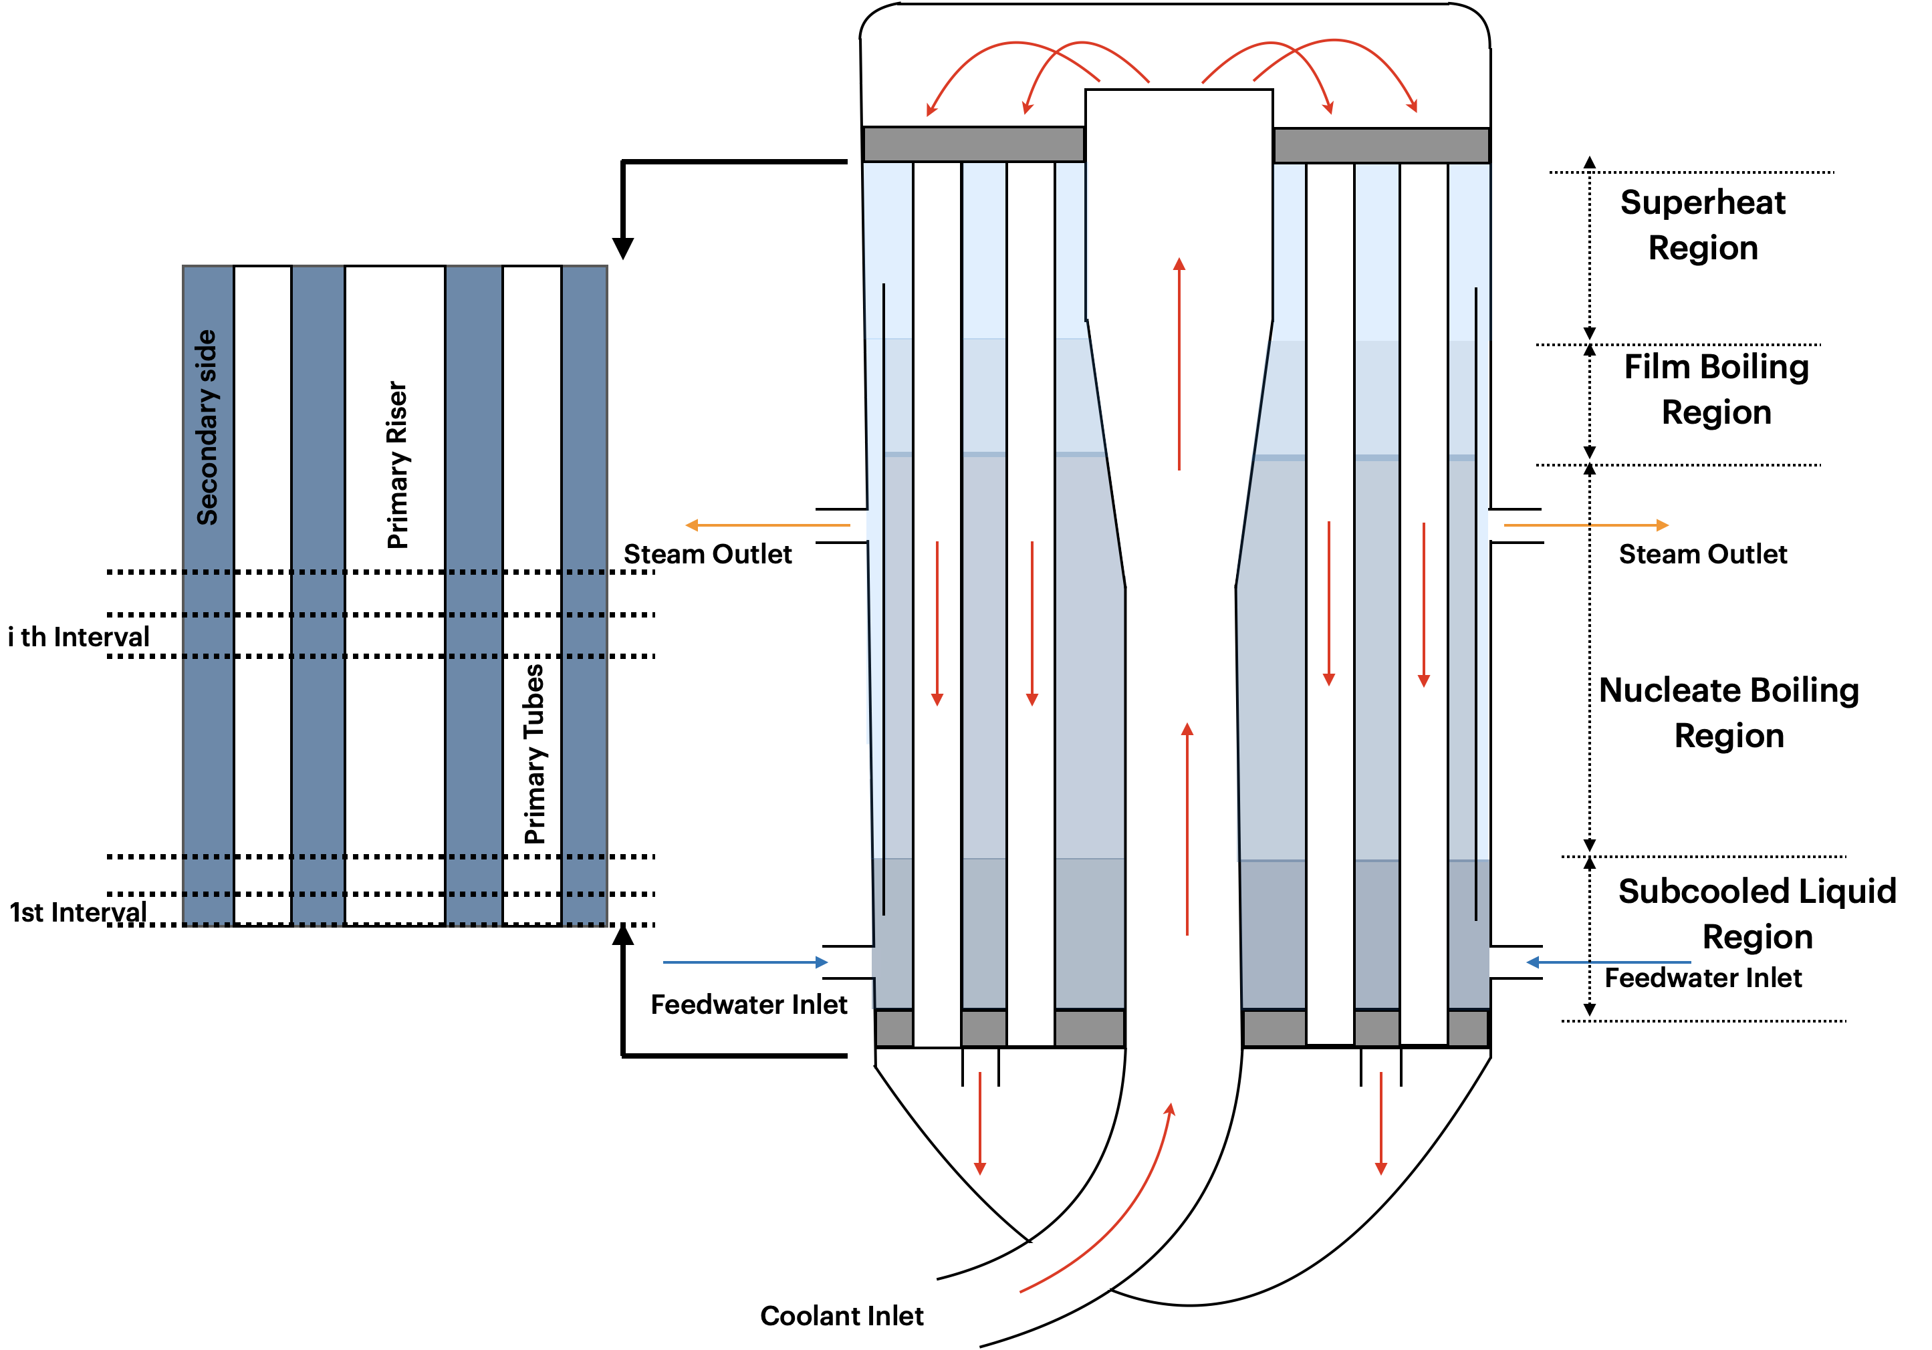
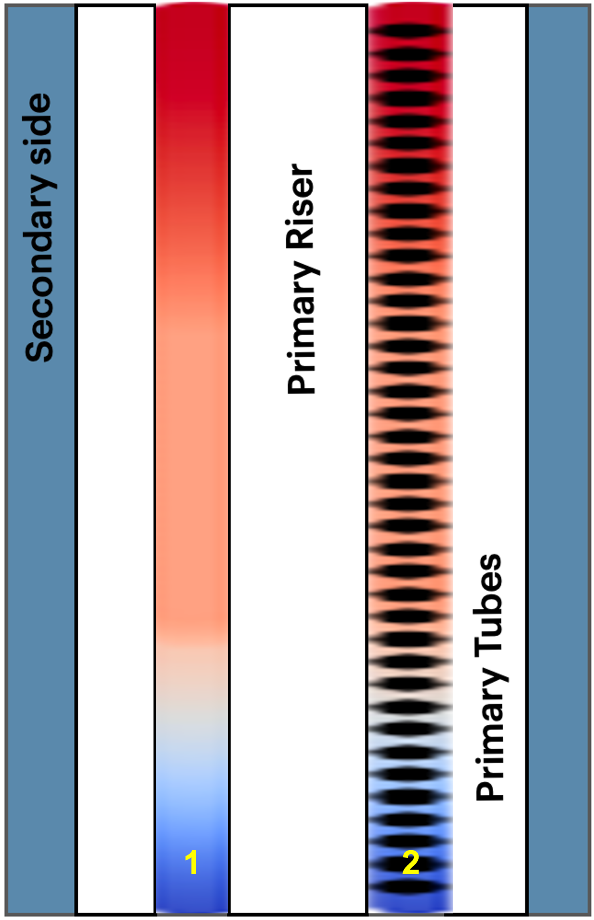
Industrial Application 2: Sensor Placement for Steam generator Design
Baffles = Constraints

Slide 15
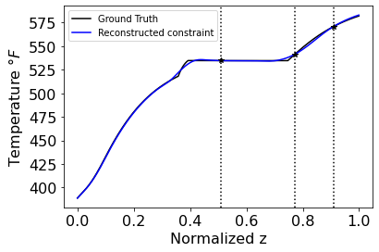
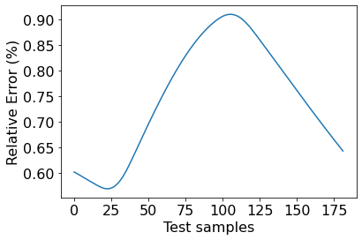
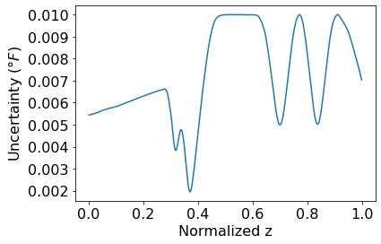
1D Steam Generator Temperature Modeling Results
a) Constrained sensor reconstruction ε = 0.9%
(b) Max reconstruction error over all test samples is 0.9%
(c) High uncertainty in temperature transition zones
Secondary side temperature profile reconstructed from 3 constrained sensors results in a maximum reconstruction error of 0.9 % over all test samples (a,b) and the maximum uncertainty in reconstruction for noisy sensor measurements is 0.01 °F (c).

Slide 16
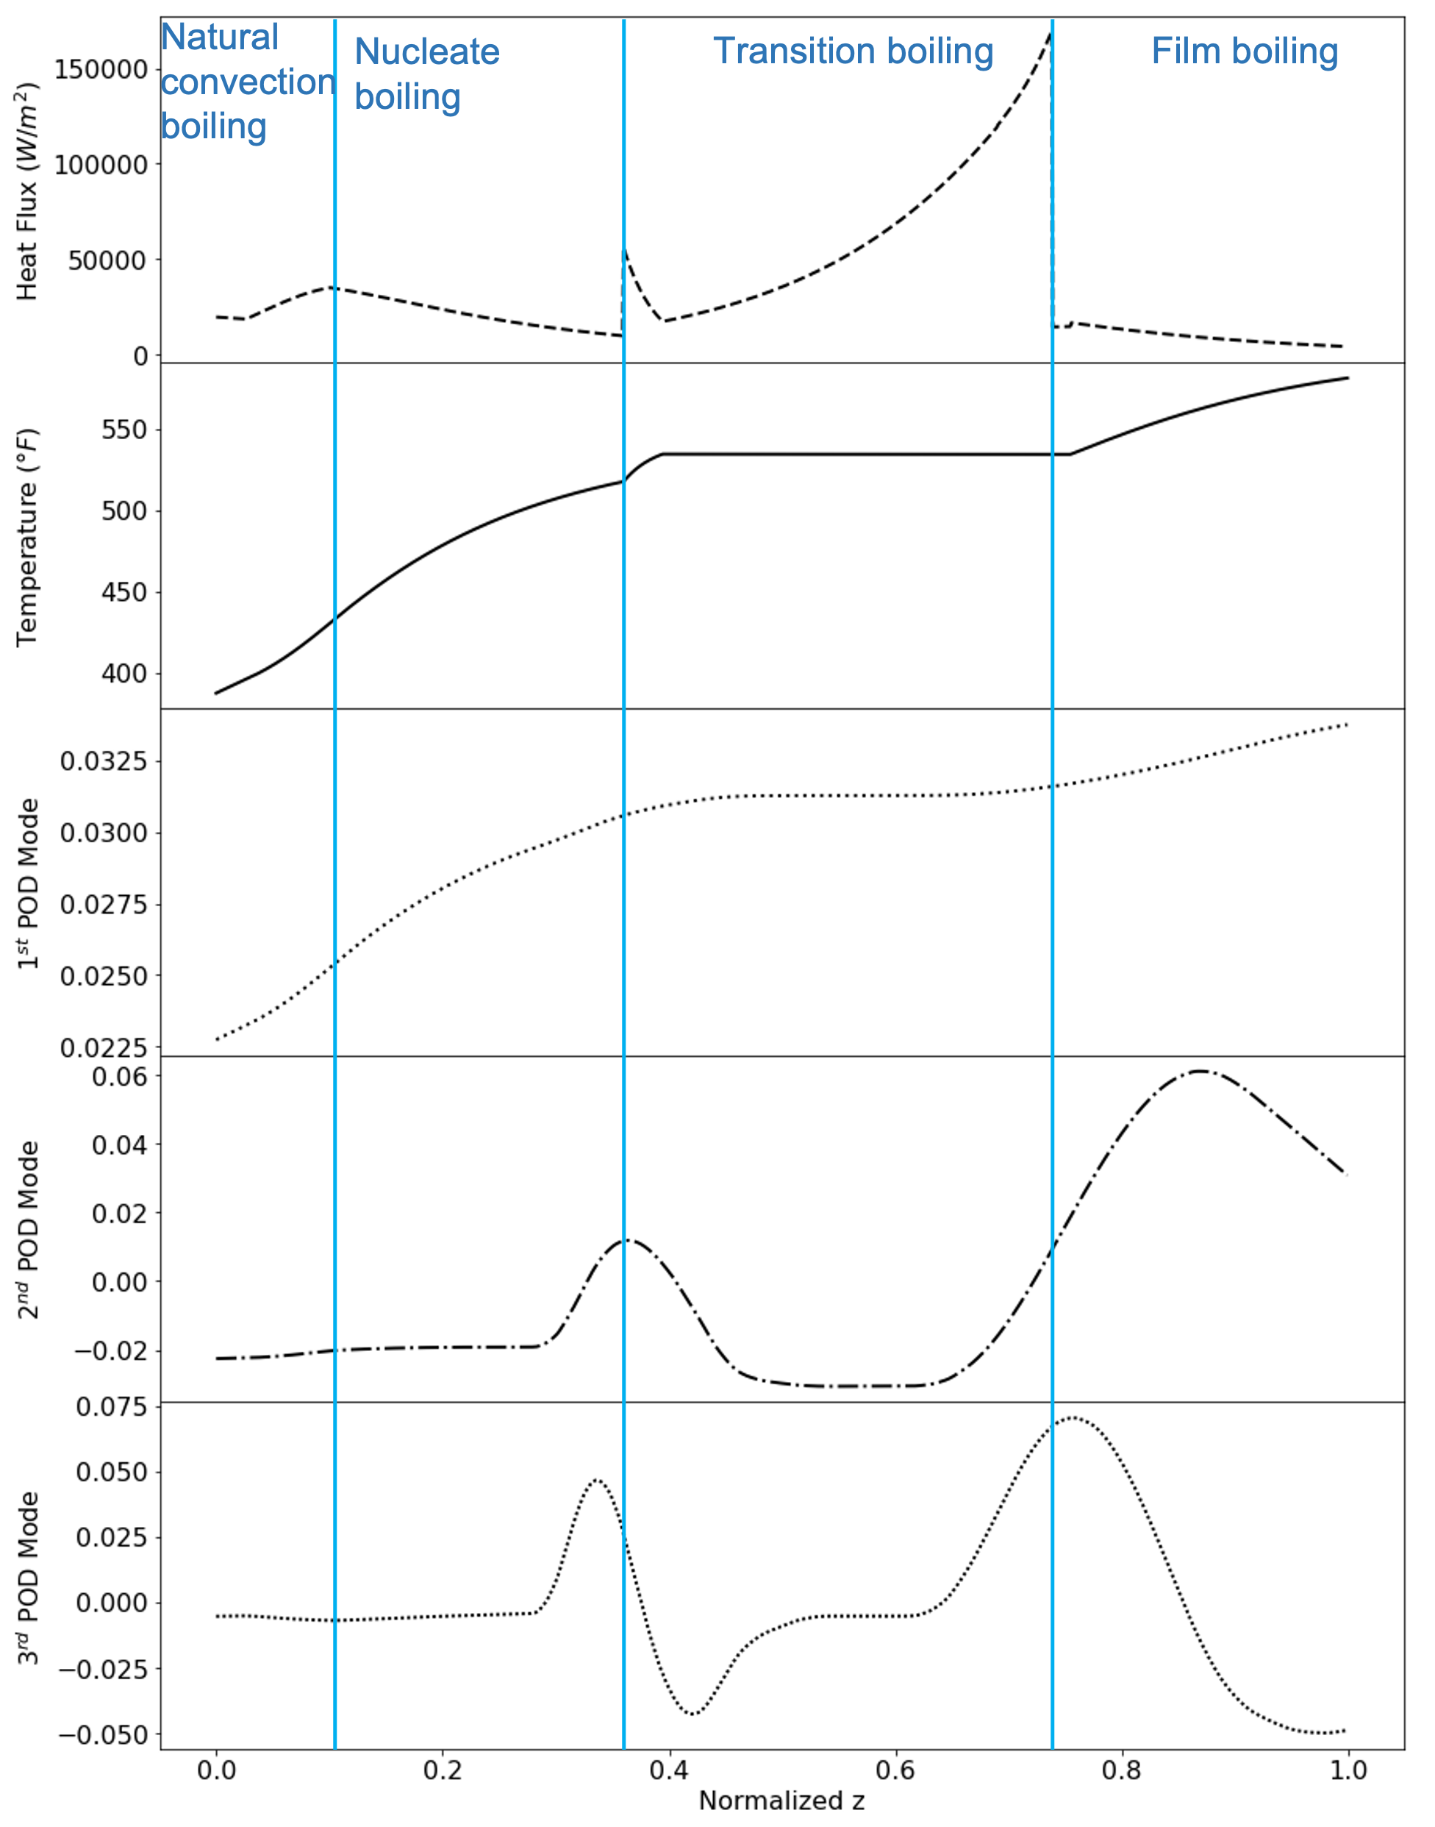
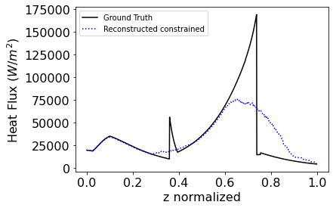
1D Steam Generator Heat Flux Modeling Results
The leading three POD modes of secondary side temperature capture 99 % of energy content and provide accurate reconstructions of temperature fields. The first POD mode captures the secondary side temperature profile whereas the 3rd POD mode captures variation in the heat flux that cause changes in temperature along the normalized z coordinates in the steam generator
Heat Flux inferred from reconstructed temperature measurements

Slide 17
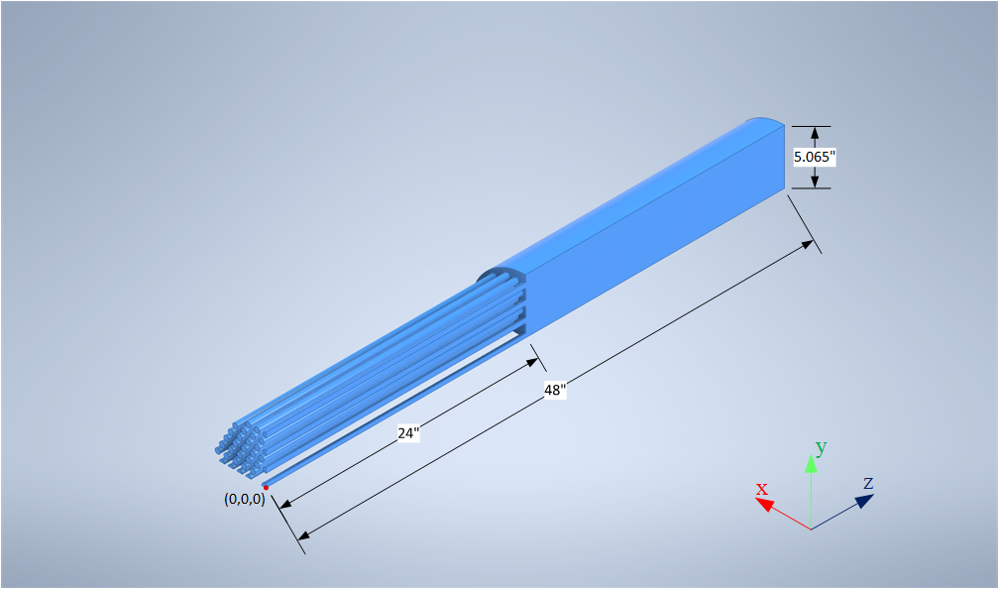
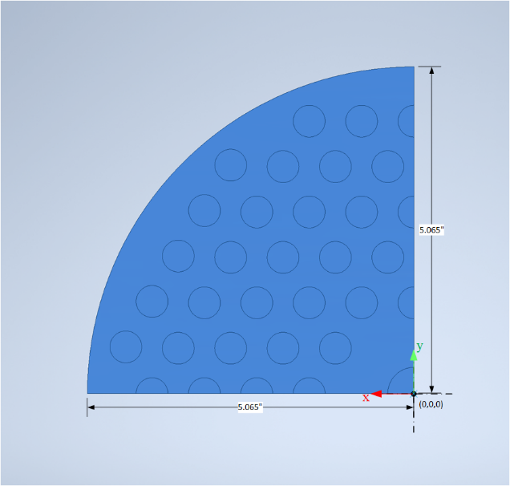
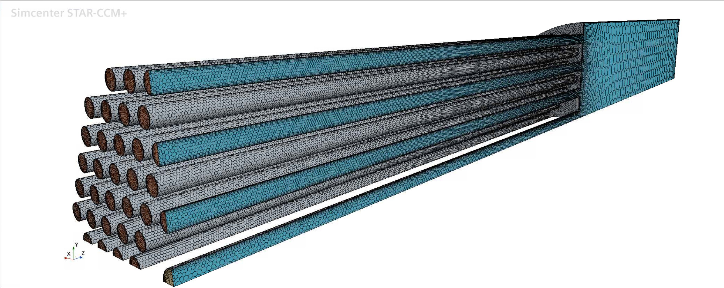
3D CFD Model of the steam generator
Figure 1. 3D CAD of 1/4th of the SG primary side fluid domain.
 | Riser | Upper Shell | SG Tubes
Quantity | 1 | 1 | 107
ID (in/m) | 0.8150/0.0207 | 10.126/0.2572 | 0.495/0.0126
OD (in/m) | 1.315/0.0334 | - | 0.625/0.0159
Length (in/m) | 451.3/11.46 | 24/0.6096 | 24/0.6096
Flow area (in²/m²) | 0.5217/3.3657x10-4 | 80.5315/0.0520 | 0.1924/1.2416x10-4
Table 1. Dimensions of the fluid domain used for CFD analysis.

Slide 18
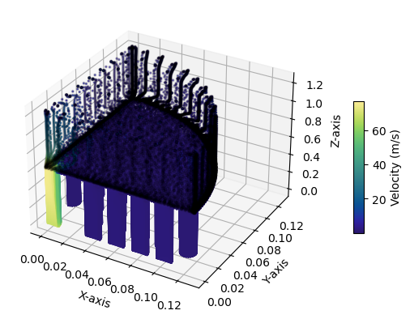
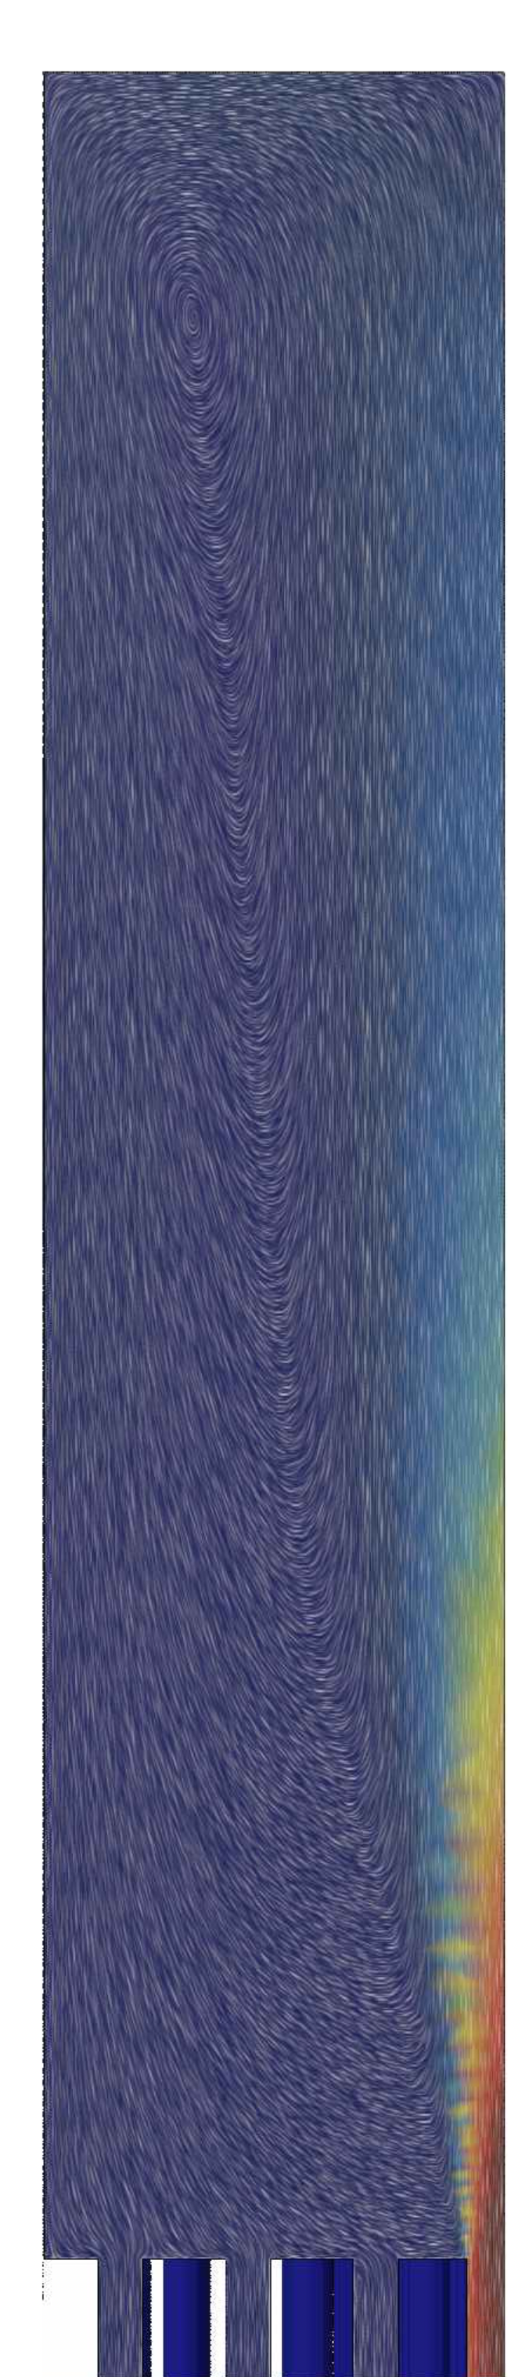
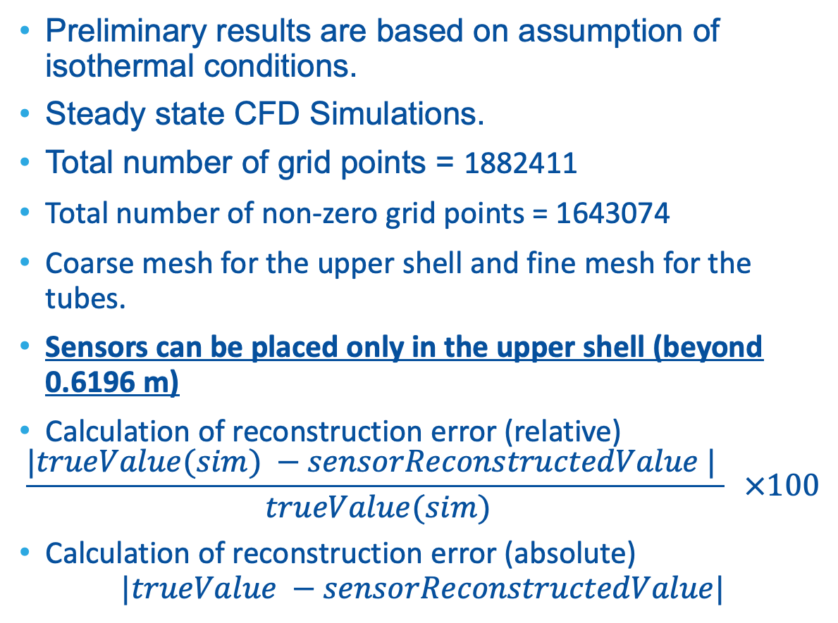
Assumptions, constraints and reconstruction comparison formulae
Preliminary results are based on assumption of isothermal conditions.
Steady state CFD Simulations.
Total number of grid points = 1882411
Total number of non-zero grid points = 1643074
Coarse mesh for the upper shell and fine mesh for the tubes.
Sensors can be placed only in the upper shell (beyond 0.6196 m)
Calculation of reconstruction error (relative)
$$\frac{|trueValue(sim) −sensorReconstructedValue | }{ trueValue(sim)} ×100$$
Calculation of reconstruction error (absolute)
$$|trueValue −sensorReconstructedValue|$$
Sensors allowed in this region

Slide 19
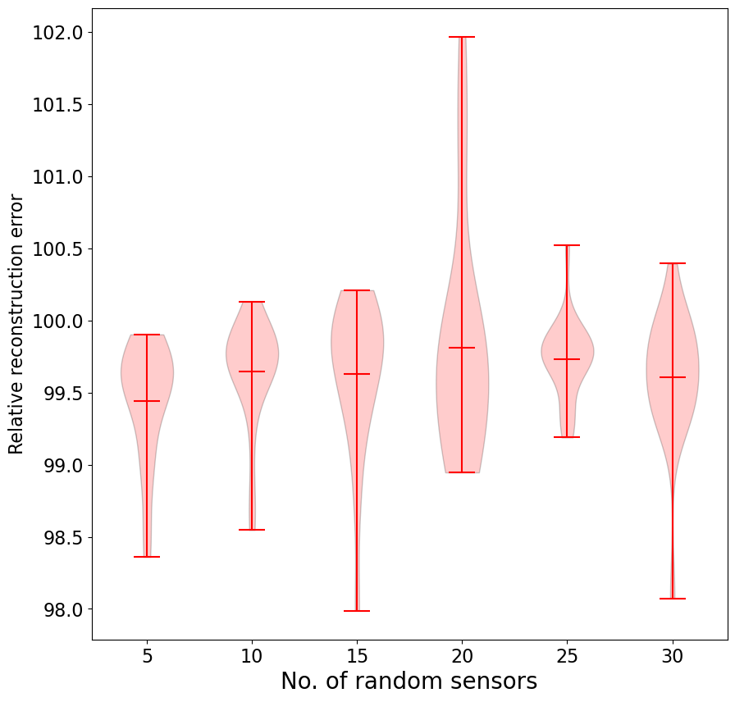
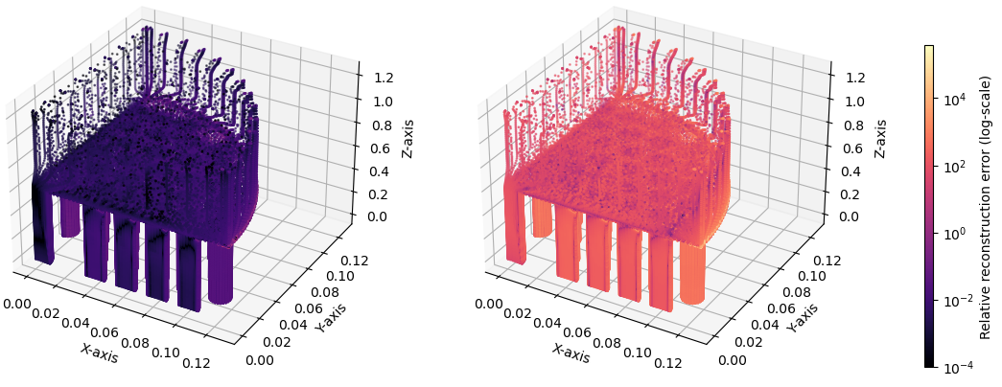
Random placement of sensors leads to very high reconstruction errors irrespective of an increase in the number of sensors
Constrained error_{rec}
Random error_{rec}

Slide 20
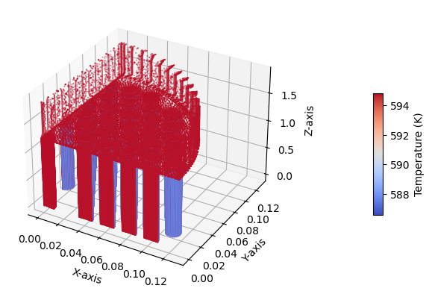
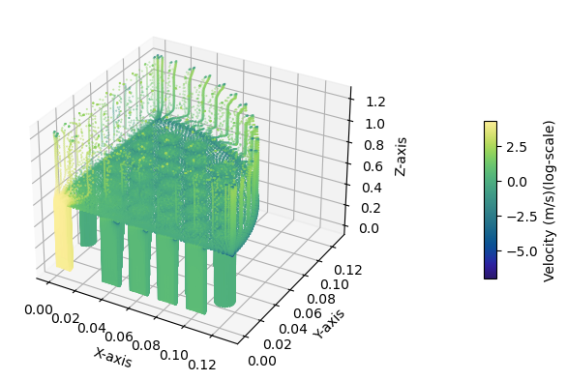
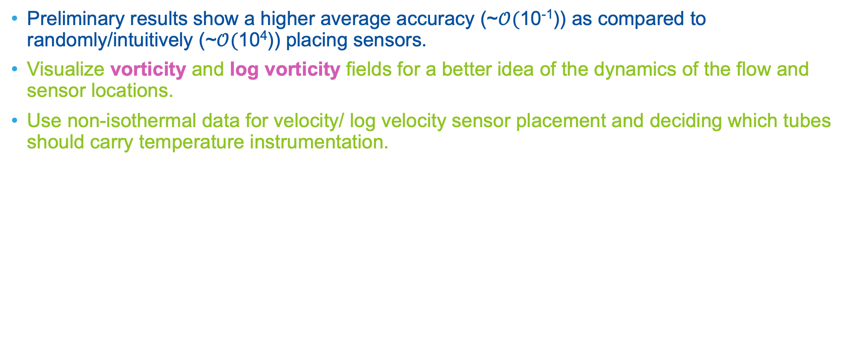
Conclusions and Future Work
Preliminary results show a higher average accuracy (~$𝒪($10⁻¹)) as compared to randomly/intuitively (~$𝒪($10⁴)) placing sensors.
Visualize vorticity and log vorticity fields for a better idea of the dynamics of the flow and sensor locations.
Use non-isothermal data for velocity/ log velocity sensor placement and deciding which tubes should carry temperature instrumentation.

Slide 21
Hands-on Session

Slide 22
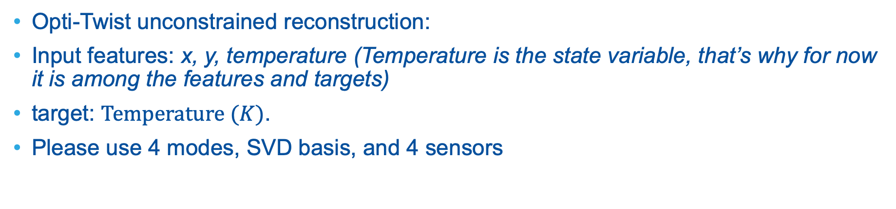
Hands-on session
Opti-Twist unconstrained reconstruction:
Input features: x, y, temperature (Temperature is the state variable, that’s why for now it is among the features and targets)
target: $Temperature (K)$.
Please use 4 modes, SVD basis, and 4 sensors
22

Slide 23
testSPSLOptiTwist.xml
Procedure: change directory (cd) to: `cd ~/projects/raven/doc/workshop/SparseSensing/exercises` (For windows you might need to add double quotes)
Add the path to the needed files in the <Files> node.
Provide the input names in the LoadCSV <IOStep>
Complete the Model in the <PostProcess> step
Complete the <Models> block:
Goal of the analysis: Is it reconstruction or classification?
features: provide all the features used in the training. Refer to the csv files
nModes, and nSensors should be set to 4. Please try different values, what happens if they are not equal?
Run the raven input: raven_framework testSPSLOptiTwist.xml
23

Slide 24
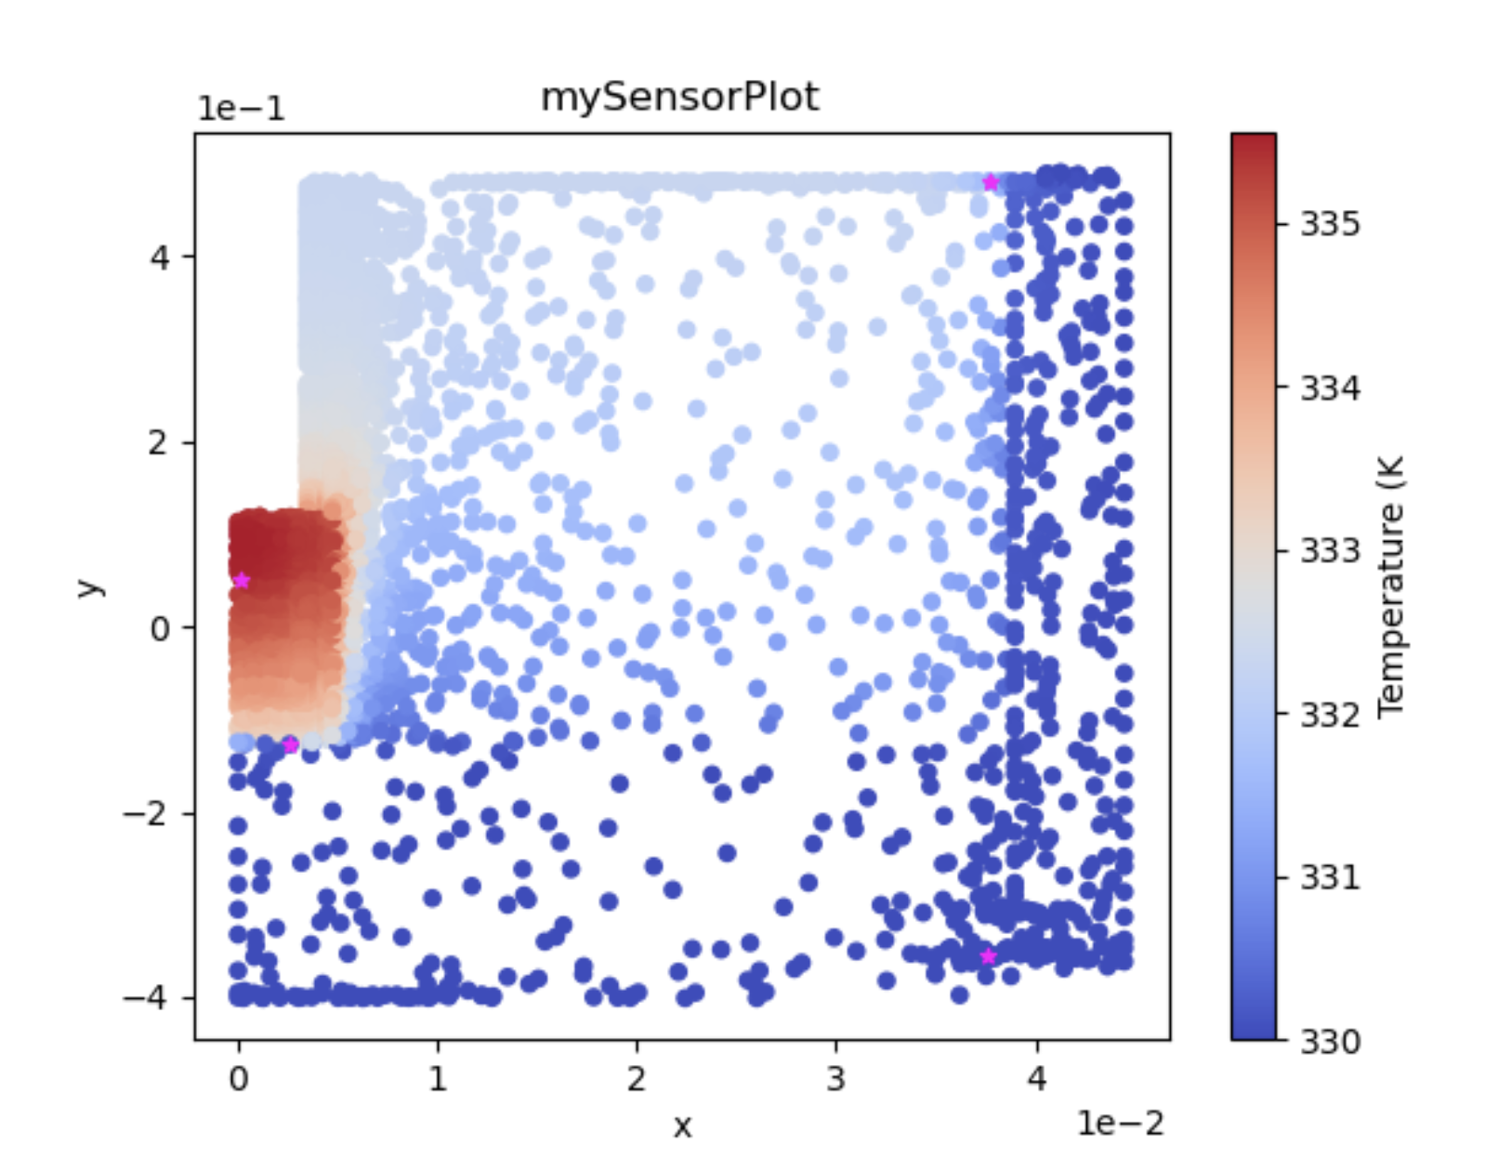
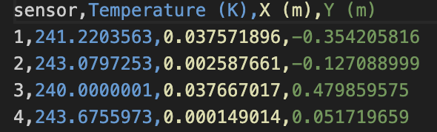
RAVEN RESULTS
24

Slide 25
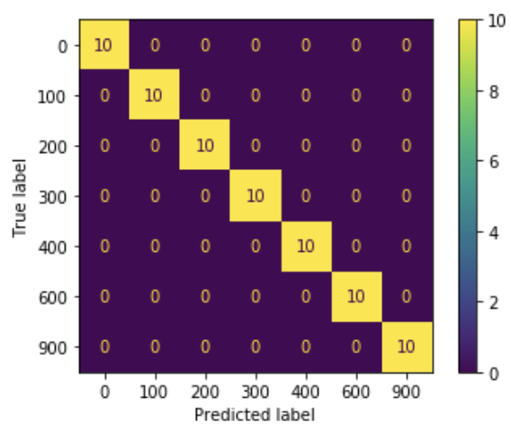
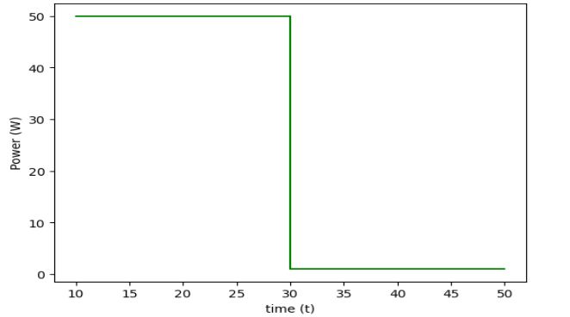
Future Work
Optimal sensor placement for multi-class classification, (predicting which accident scenario (Loss of Coolant Accident (LOCA), loss of power, etc.)
Using Mutual Information and Entropy-based metrics for sensor placement.
Comparing sensor selection to other feature selection algorithms and utilize them to improve selection of sensors.
Measuring a certain field of interest (e.g., temperature) and inferring another field of interest (e.g., velocity).
Anomaly detection
Tensor decomposition instead of Singular value decomposition (SVD) when we have time and samples.
Implementing constrained sensor placement in RAVEN.
Confusion Matrix

Slide 26

Thanks for attention!

Slide 27
Krithika Manohar, J Nathan Kutz, and Steven L Brunton. “Optimal sensor and actuator selection using balanced model reduction”. In: IEEE Transactions on Automatic Control 67.4 (2021), pp. 2108–2115.
Karnik, N., Abdo, M. G., Estrada-Perez, C. E., Yoo, J. S., Cogliati, J. J., Skifton, R. S., ... & Manohar, K. (2024). “Constrained optimization of sensor placement for nuclear digital twins.” IEEE Sensors Journal. (published 02/28/2024)
Karnik, N., M. G. Abdo, and K. Manohar. “Optimal Sparse Sensor Placement with Adaptive Constraints for Nuclear Digital Twins." 75th Annual Meeting of the APS Division of Fluid Dynamics (APS DFD 2022) November 20-22, 2022, Indianapolis, IN.
DICE 2024: presentation about applications of sparse sensing in nuclear digital twins.
Karnik, N., Abdo, M. G., Manohar K. “Data-Driven Sensor Placement for Nuclear Reactor Transient Analyses in Digital Twins”. Bulletin of the American Physical Society
AI Institute in Dynamic Systems CTF workshop (Sponsored by NSF)
PHSOR 2024, Scintific ML workshop: “Sparse sensing and Sparse Learning for Nuclear Digital Twins.”
References

Slide 28

